Slide 1


Slide 2


Slide 3
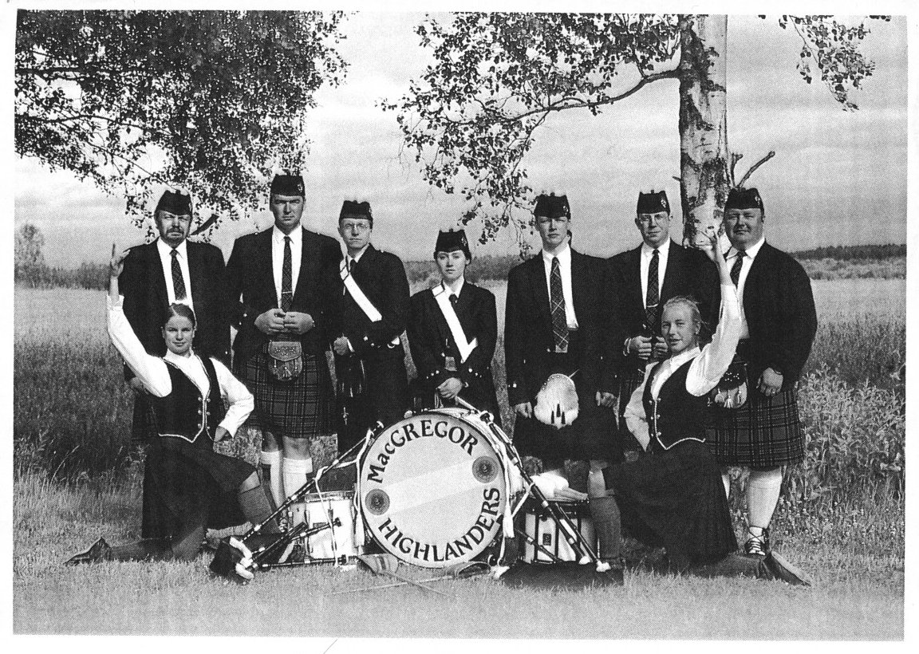

1991 - 2016

Slide 4
1991 - 2016

